Slide 1
INFO 656-01 Fall 2020 Evaluation, Tuning, Feature Processing
Week 7
Amir Imani

Slide 2
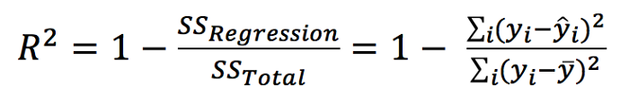
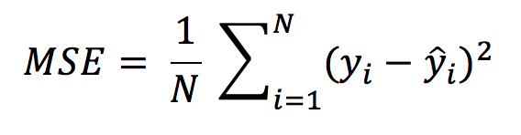
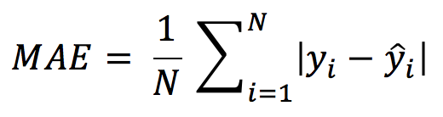
Metrics for Regression Models
R^{2:}
(R)MSE
Mean/Median Absolute Error
Notes:
R2: coefficient of determination –
R Square is calculated by the sum of squared of prediction error divided by the total sum of square which replace the calculated prediction with mean.
Best possible score is 1.0 and it can be negative (because the model can be arbitrarily worse). A constant model that always predicts the expected value of y, disregarding the input features, would get a R^2 score of 0.0.
MSE: easy to relate to input – measure of how close a fitted line is to data points - the average magnitude of the errors in a set of predictions, without considering their direction.
RMSE:That is probably the most easily interpreted statistic, since it has the same units as the quantity plotted on the vertical axis.
MAE: more robust

Slide 3
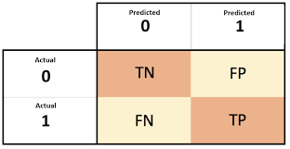
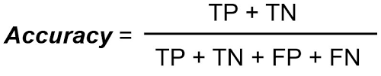
Metrics for Classification Models

Slide 4
Problem with Accuracy
n=100 | Predicted No | Predicted Yes
Actual No | 40 | 10
Actual Yes | 5 | 45

Slide 5
Problem with Accuracy
n=100 | Predicted No | Predicted Yes
Actual No | 50 | 0
Actual Yes | 15 | 35
n=100 | Predicted No | Predicted Yes
Actual No | 35 | 15
Actual Yes | 0 | 50

Slide 6
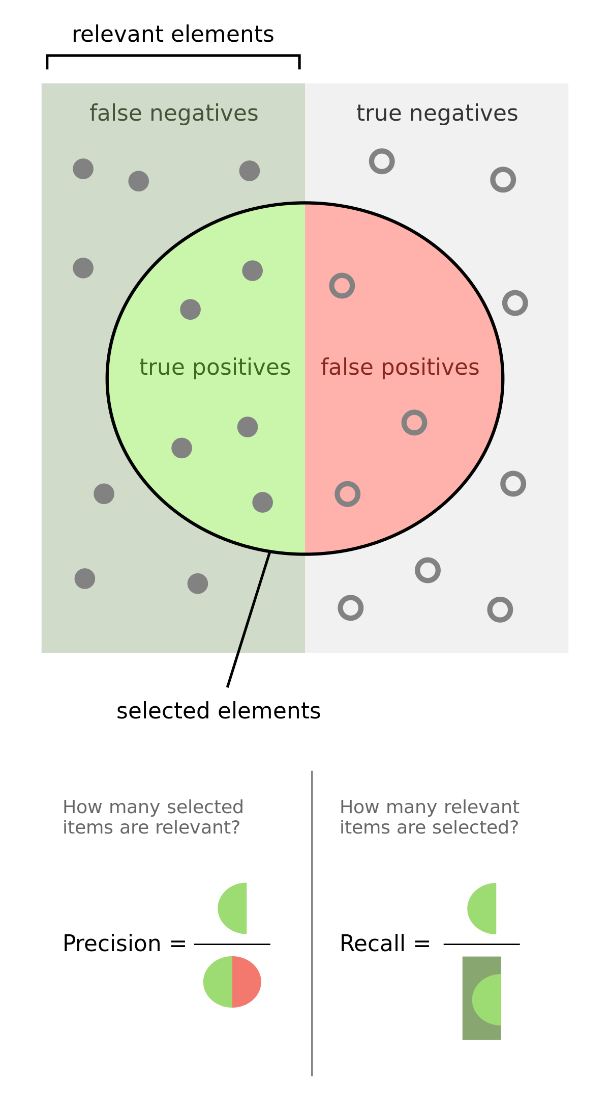
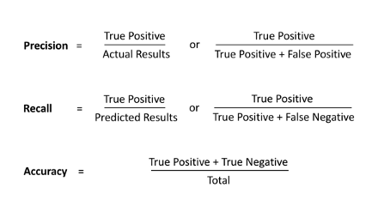
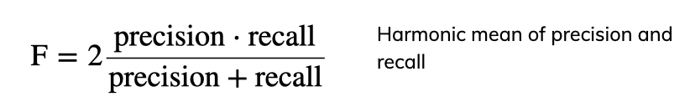
Precision, Recall, f-score
https://medium.com/datadriveninvestor/confusion-matric-tpr-fpr-fnr-tnr-precision-recall-f1-score-73efa162a25f
Notes:
The harmonic mean is often used to calculate the average of the ratios or rates. It is the most appropriate measure for ratios and rates because it equalizes the weights of each data point.

Slide 7
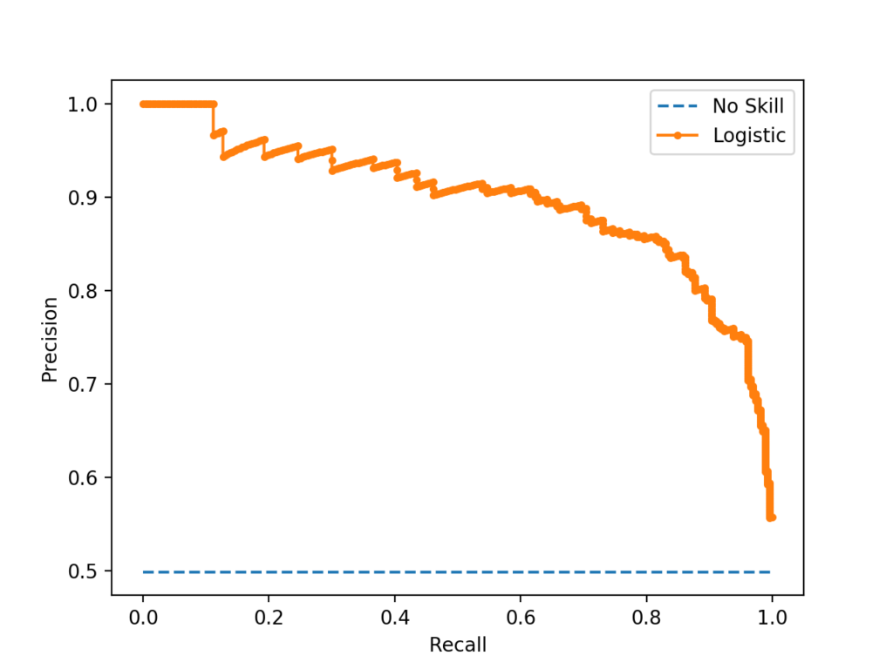
Precision-Recall Curve
Precision-Recall curves summarize the trade-off between the true positive rate and the positive predictive value for a predictive model using different probability thresholds.
Appropriate when data is imbalanced
https://machinelearningmastery.com/roc-curves-and-precision-recall-curves-for-imbalanced-classification/

Slide 8
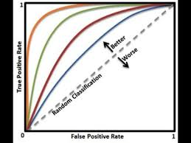
ROC curve
ROC Curves summarize the trade-off between the true positive rate and false positive rate for a predictive model using different probability thresholds.
A ROC curve is constructed by plotting the true positive rate (TPR) against the false positive rate (FPR).
Is appropriate when the observations are balanced between each class
As a baseline, a random classifier is expected to give points lying along the diagonal (FPR = TPR). The closer the curve comes to the 45-degree diagonal of the ROC space, the less accurate the test.
https://www.youtube.com/watch?v=J9l8J1MeCbY

Slide 9
Imbalanced data
Imbalanced cost – imbalanced data
Accuracy is not the best metric to use
Remedies?
Model: try different models, class weights, loss function
Data: resample (over/under), create synthetic data
Notes:
Instead of repeating samples, re-weight the loss function.
Works for most models!
Same effect as over-sampling (though not random), but not as expensive (dataset size the same).

Slide 10
Imbalanced data
Imbalanced cost – imbalanced data
Accuracy is not the best metric to use
Remedies?
Model: try different models, class weights, loss function
Data: resample (over/under), create synthetic data
Notes:
Instead of repeating samples, re-weight the loss function.
Works for most models!
Same effect as over-sampling (though not random), but not as expensive (dataset size the same).

